Slide 1
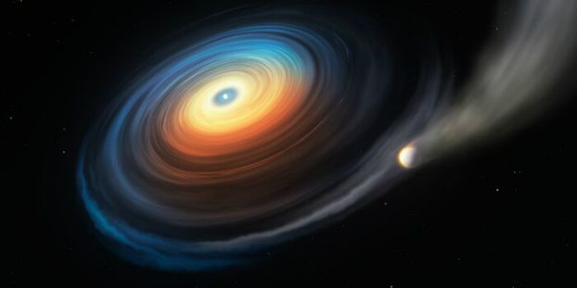



BAYESIAN SYSTEM IDENTIFICATION AND PREDICTIVE ALGORITHMS IN WAVEFRONT SENSING AND CONTROL FOR EXOPLANET IMAGING
Internship Supervisors
Laurent PUEYO
Colin NORMAN
ENS Supervisor
Mohamed ABBAS-TURKI

Slide 2
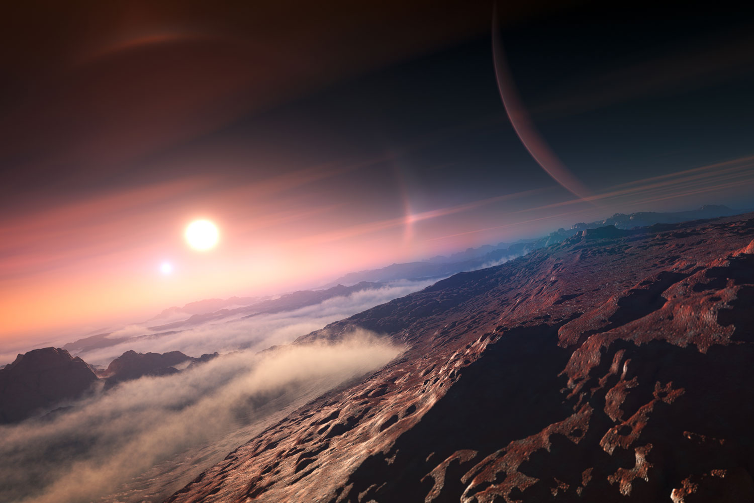
SUMMARY
1 |
Context
2 |
Methods
3 |
Results
4 |
Conclusion

Slide 3
SUMMARY
1 |
Context
2 |
Methods
3 |
Results
4 |
Conclusion

Slide 4
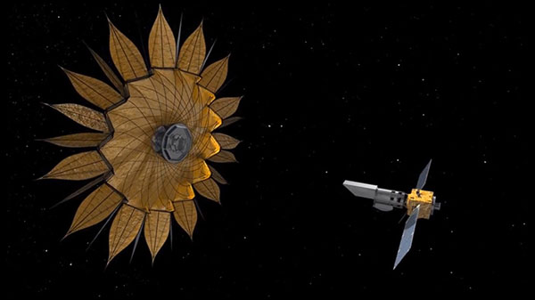
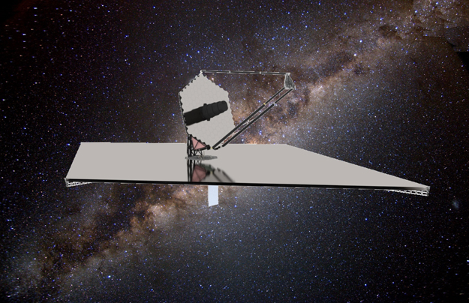
CONTEXT Direct Imaging of Exoplanets
The key scientific objective of future NASA astrophysics flagship missions is to find out if there is life elsewhere in our universe, through two major projects:
Habitable Exoplanet Observatory (HabEx)
Large UV/Optical/Infrared Surveyor (LUVOIR)
Scientific goals:
SEARCH FOR EARTH-LIKE PLANETS
Are there terrestrial planets with similar atmospheres?
SEARCH FOR LIFE
Does extraterrestrial life exist?
SEARCH FOR SOLAR SYSTEM ROLE IN THE UNIVERSE
What does it have of typical or atypical?

Slide 5


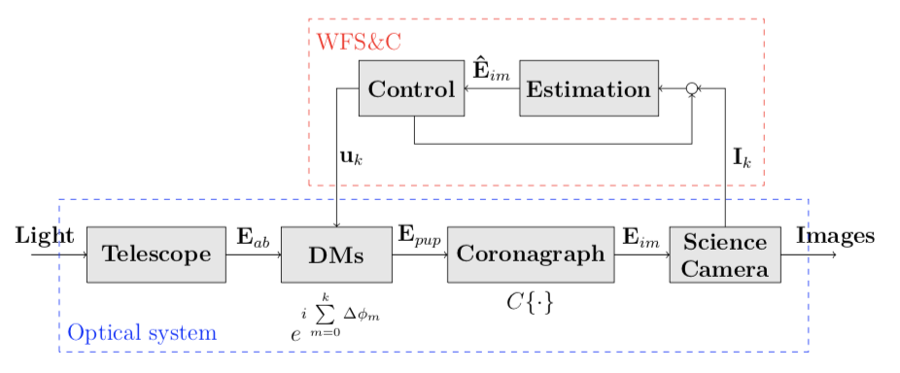
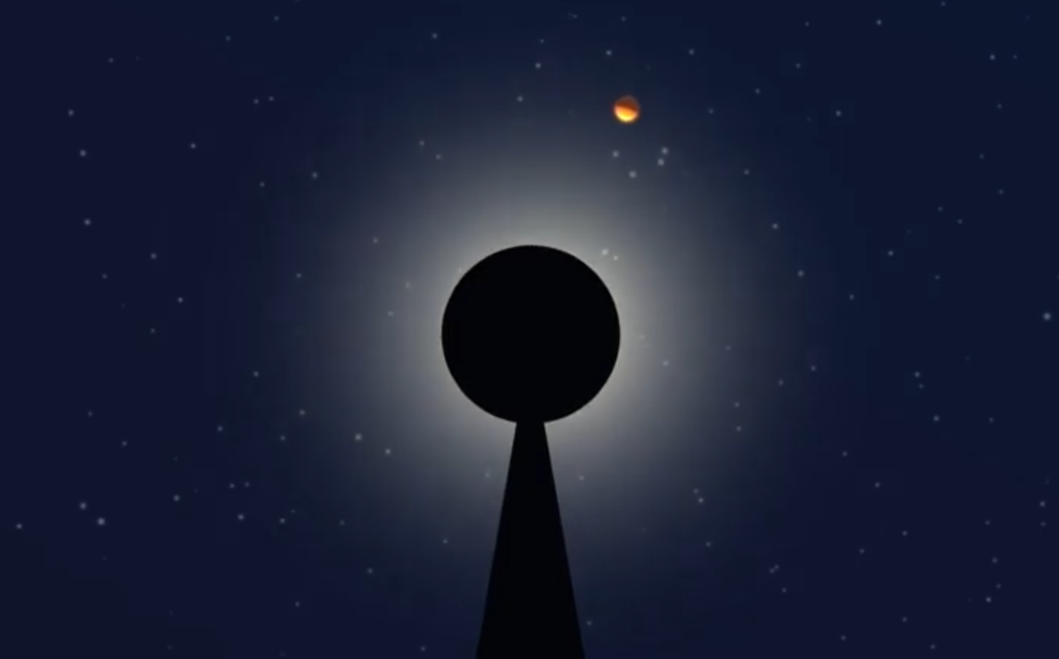

CONTEXT Reinventing the Optical System
What we have now
From a block diagram perspective:
OPTICAL INSTRUMENTS
WAVEFRONT SENSING AND CONTROL (WFS&C) ALGORITHMS
What we want in 2030
Design of optical instruments and
WFS&C algorithms go hand-in-hand
These methods have never been sent to space yet

Slide 6
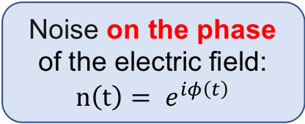

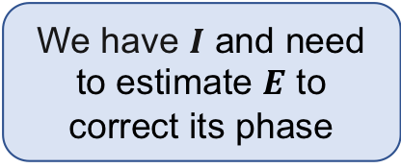
CONTEXT Model of the Optical System
Deformable Mirrors have a small actuation
Coronagraph has a linear influence
Linearity assumption:
$E_{im,k}=E_{im,k−1}+G_{k}u_{k}$
Noise on the phase of the electric field: $n\left(t\right)= e^{iφ\left(t\right)}$
We have $I$ and need to estimate $E$ to correct its phase

Slide 7


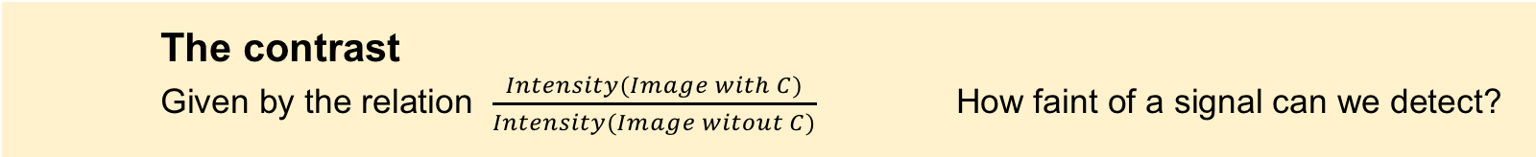
CONTEXT Most Important Metrics
Finally, the two main metrics we use are:
The observation time
Computation time
Lost time on the telescope
The contrast
Given by the relation $\frac{Intensity(Image with C)}{Intensity(Image witout C)}$ How faint of a signal can we detect?
We want them as small as possible

Slide 8
SUMMARY
1 |
Context
2 |
Methods
3 |
Results
4 |
Conclusion

Slide 9
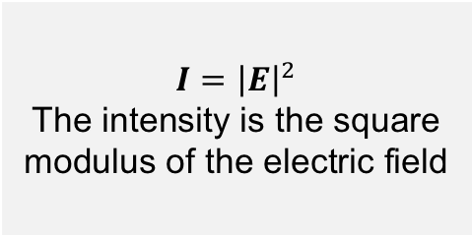

METHODS Introduction to the Estimation Problem
Currently: estimation of $E$ from $I$
Currently: estimation of 𝑬 from 𝑰
Statistical methods
Future: estimation of $E$ from $E$
Future: estimation of 𝑬 from 𝑬
How to estimate the electric field $E$?
$$I={\left|E\right|}^{2}$$
The intensity is the square modulus of the electric field

Slide 10
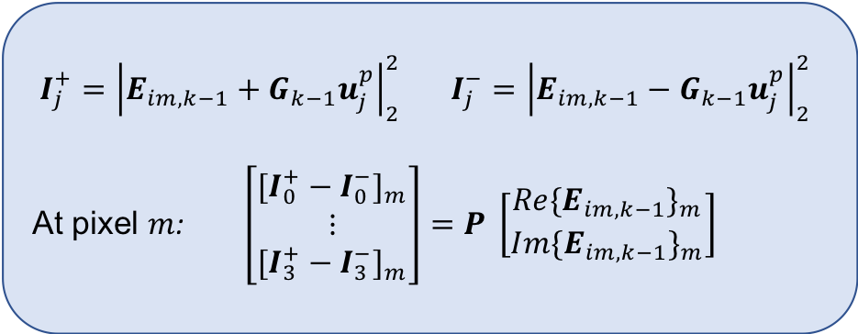
METHODS State of the Art – Pairwise Estimation
Idea: Choose a set of probe functions $u_{j}^{p}$ that will be applied to DMs and measure resulting intensity patterns
$$I_{j}^{+}={\left|E_{im,k−1}+G_{k−1}u_{j}^{p}\right|}_{2}^{2} I_{j}^{−}={\left|E_{im,k−1}−G_{k−1}u_{j}^{p}\right|}_{2}^{2}$$
At pixel $m$: $\left[\begin{matrix}{{[I}_{0}^{+} − I_{0}^{−}]}_{m} \\ ⋮ \\ {{[I}_{3}^{+} − I_{3}^{−}]}_{m}\end{matrix}\right]=P \left[\begin{matrix}{{Re\{E}_{im,k−1}\}}_{m} \\ {{Im\{E}_{im,k−1}\}}_{m}\end{matrix}\right]$
Use measured intensities along with forward model to construct system of equations and solve for real and imaginary part of field at each pixel in dark zone
Pairwise Estimation
Only used method currently
Probing creates a huge loss in observation time
Need for new algorithms

Slide 11
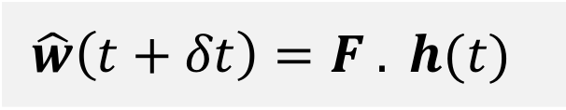
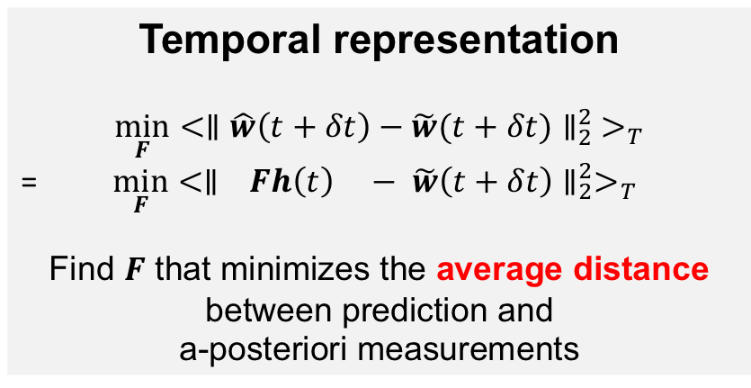
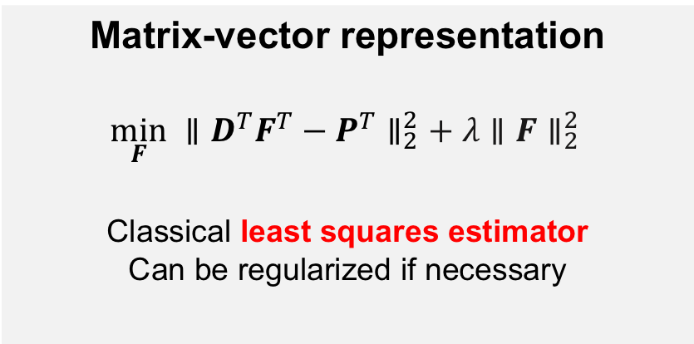
METHODS Predictive Filter – Presentation
Temporal representation
$$\min_{F}{<{∥\hat{w}\left(t+δt\right)−\tilde{w}(t+δt)∥}_{2}^{2} >_{T}}$$
=$\min_{F}{<∥ { Fh\left(t\right) − \tilde{w}\left(t+δt\right)∥}_{2}^{2}>_{T}}$
Find $F$ that minimizes the average distance between prediction and
a-posteriori measurements
Estimate at the next step
$$\hat{w}\left(t+δt\right)=F . h(t)$$
Matrix-vector representation
$$\min_{F} {∥D^{T}F^{T}−P^{T}∥}_{2}^{2}+ λ{∥F∥}_{2}^{2 }$$
Classical least squares estimator
Can be regularized if necessary
Filter
History of past wavefronts

Slide 12
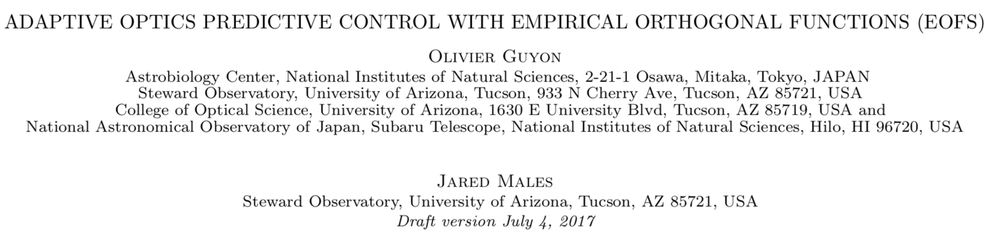
METHODS Origin of the Algorithm
Previous application: Control of the atmospheric turbulence on ground telescopes
MATHEMATICAL UNDERSTANDING
Time series analysis
Singular values decomposition
Regularized least squares
VALIDATION OF THE ALGORITHM
Python & packages
Jupyter notebooks
Analysis of relevant metrics
IMPLEMENTATION ON THE TESTBED
Version control (Git)
Integrated development environment (PyCharm)
Progression of the internship

Slide 13

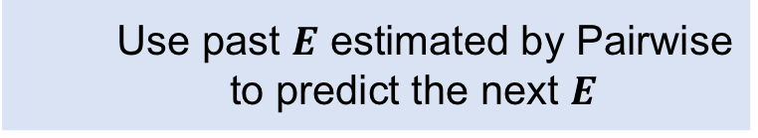
METHODS Predictive Filter – Advantages
EOFs
Best estimator in the least squares sense
Allows the incorporation of different types of data
Possible to estimate$E$ at every pixel
Possible to estimate 𝑬 at every pixel
Don’t need a model for the data
Use past $E$ estimated by Pairwise to predict the next $E$

Slide 14
SUMMARY
1 |
Context
2 |
Methods
3 |
Results
4 |
Conclusion

Slide 15
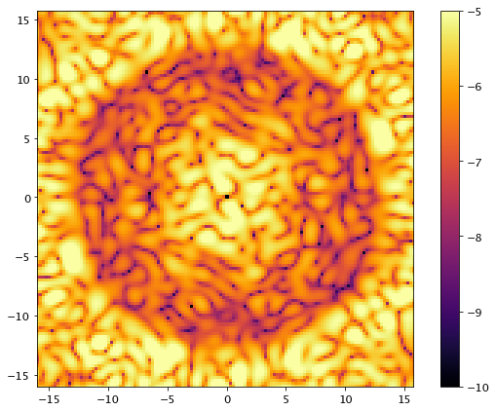
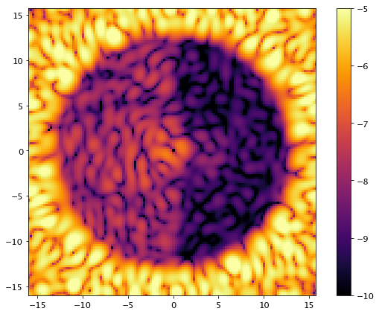
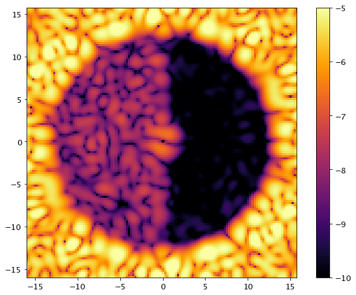
RESULTS Dark Hole Creation
Idea: Create a zone of very low contrast, the dark hole
Control
Estimation
DARK HOLE CREATION
Pairwise estimation
Control algorithm
DARK HOLE MAINTENANCE
Mix Pairwise & Filter
Control algorithm

Slide 16
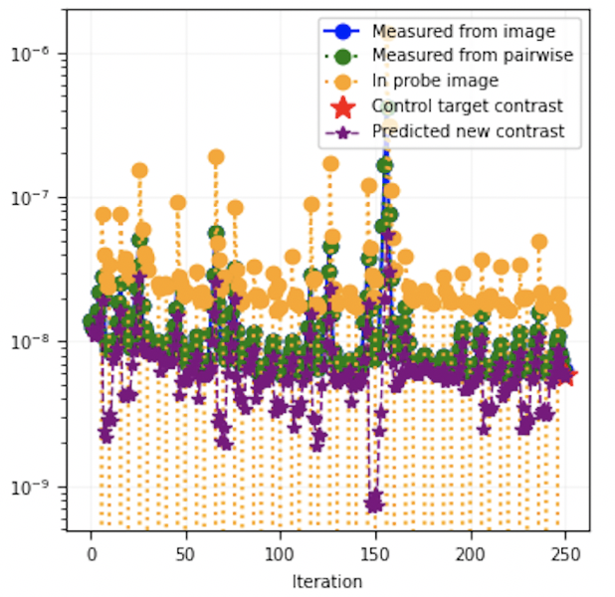
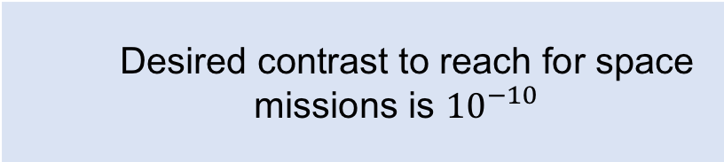
RESULTS Algorithm Implementation on the Testbed Simulator
Metric What is the dark hole maintenance contrast using the predictive filter?
Desired contrast to reach for space missions is ${10}^{−10}$
Contrast vs Iterations
Contrast is similar to the lowest values we can currently achieve

Slide 17
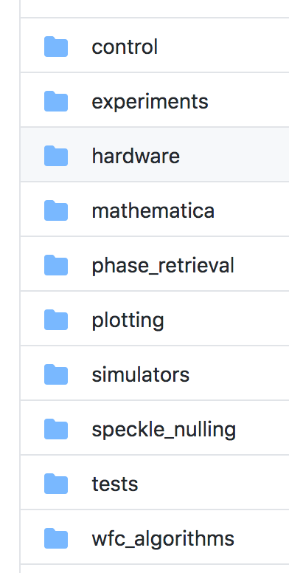
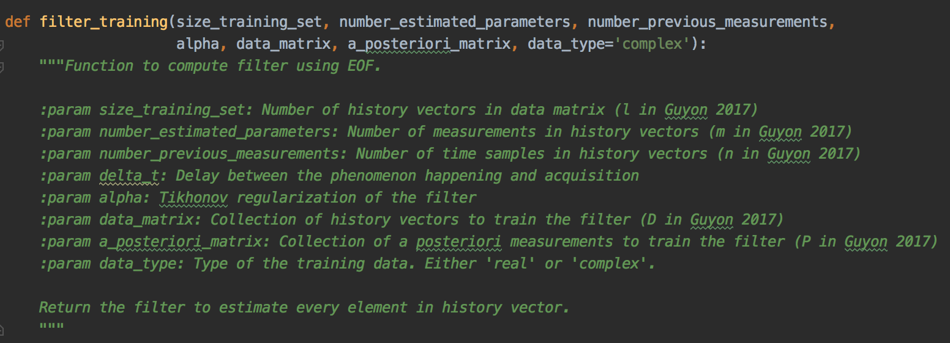
RESULTS Algorithm Implementation on the Testbed
MODULE CREATION
- Using Python & HciPy
- Includes accommodating functions (initialization, SVD truncature, etc…)
IMPLEMENTATION ON THE TESTBED
- Using Version Control
- Can directly call the functions in the main branch

Slide 18
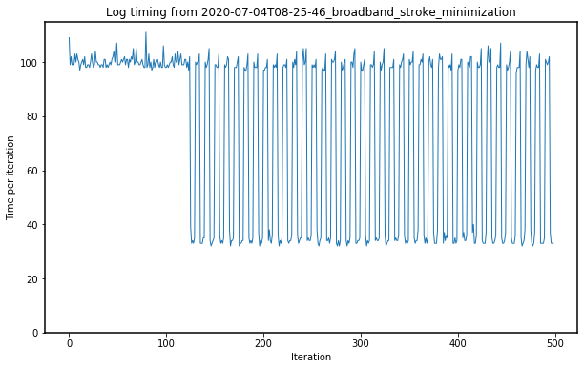
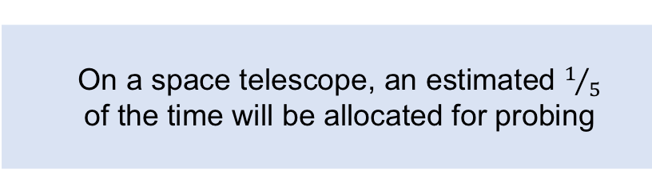
RESULTS Algorithm Implementation on the Testbed
Metric What is the gain in time with the predictive filter?
On a space telescope, an estimated $1/5$
of the time will be allocated for probing
Time difference between Predictive filter and Pairwise estimation
Huge reduction in computing time
No need for probes anymore

Slide 19
SUMMARY
1 |
Context
2 |
Methods
3 |
Results
4 |
Conclusion

Slide 20
CONCLUSION Achievements
UNDERSTOOD
VALIDATED
IMPLEMENTED
FINE-TUNED
The algorithm has been:

Slide 21
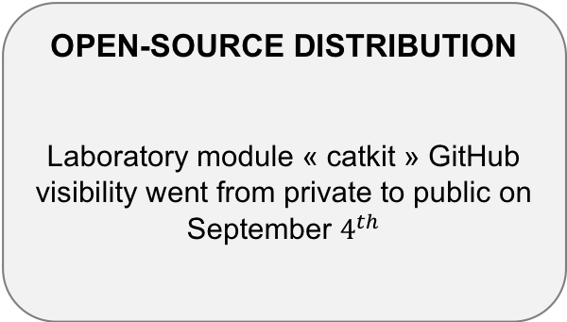
CONCLUSION Impact
In the laboratory
And elsewhere
IMPLEMENTED ON THE TESTBED
Code is running on the laboratory testbed, which was the ultimate goal of the internship
OPEN-SOURCE DISTRIBUTION
Laboratory module « catkit » GitHub visibility went from private to public on September $4^{th}$
ARTICLE IN PREPARATION
In collaboration with the University of California Santa Cruz
EXPAND ON OTHER TESTBEDS
Princeton University
Goddard Space Flight Center
University of Arizona

Slide 22
Thank you

Slide 24
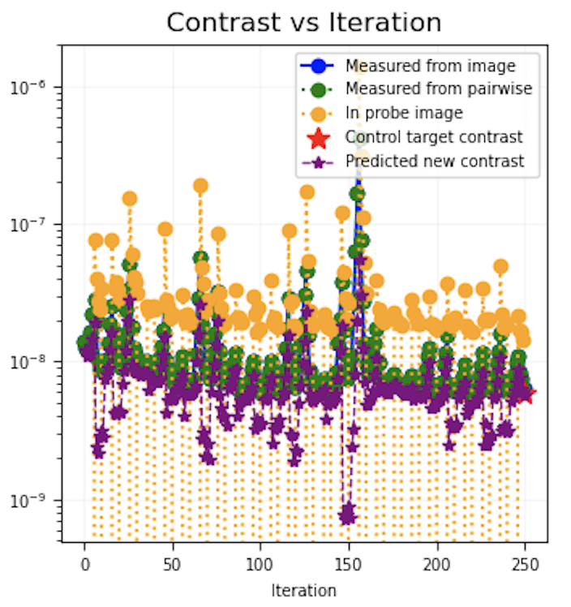
RESULTS Algorithm Validation – Algorithm in Practice (1)
Discussion on Training Set
1e-3, 80/5 (l,n)

Slide 25
RESULTS Algorithm Validation – Algorithm in Practice (2)
Discussion on regularization
Need to recompute filter frequently for now Find right value for the parameters

Slide 26

APPENDIX Future Research
What will future research focus on?
Find tradeoff between code architecture and optics architecture
Determine good filter parameters
Find right number of vectors in the training set
Find right value for the regularization
Determine optimal architecture
Which computation power do we have?
Study autocorrelation in history vectors
Study filter "breakpoint"
Research on optics and materials
Investigate segmented apertures

